Slide 1
COS 326 Database Systems
Lecture 6
Object-Relational Databases (2)
Chapter 12 (7th edition)
Thursday 08 August 2024

Slide 2
In this lecture
PostgreSQL
Relationship between Postgres, SQL:2011 & PostgreSQL
PostgreSQL basics
ODMG Object Model and the Object Definition Language ODL
Object Database Conceptual Design
The Object Query Language OQL

Slide 3
1. Postgres, SQL:2011 & PostgreSQL
Originally postgres, renamed PostgreSQL in 1996
query language postquel was replaced with SQL
PostgreSQL uses a client/server model. A session consists of:
(1) A server process ( called postgres )
manages the database files
accepts connections to the database from client applications,
performs database operations on behalf of the clients.
(2) Users’ client (front end) applications
make requests for database operations.
Uses SQL + extensions for OOP as defined in SQL:2011 + other postgres specific features

Slide 4
PostgreSQL: Demo Time
PostgreSQL Demo
For the next 10-15 minutes, follow on the demo

Slide 5
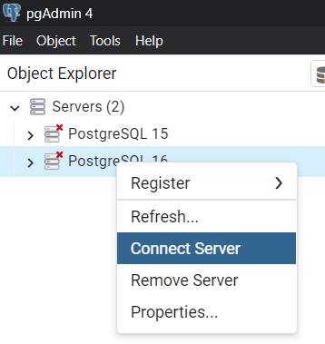
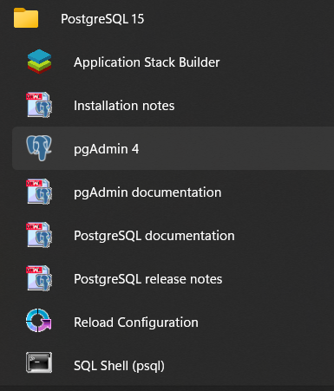
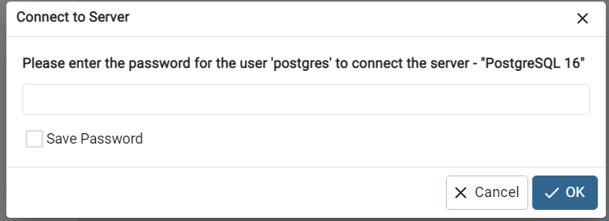
2. Using PostgreSQL in Windows (1)
Installation: Run postgresql-16.3-2-windows-x64.exe
MS Windows 11
Menu
pgAdmin 4
database admin tool for PostgreSQL

Slide 6
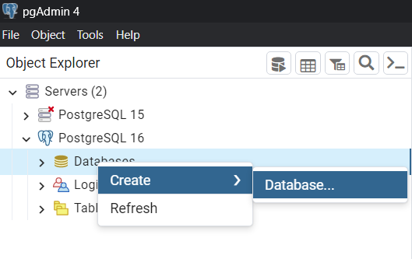
2. Using PostgreSQL in Windows (2a)
pgAdmin 4 (database admin tool for PostgreSQL)

Slide 7
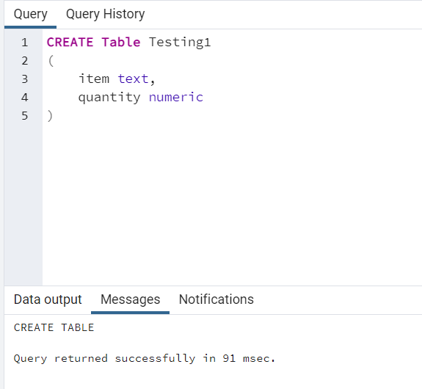
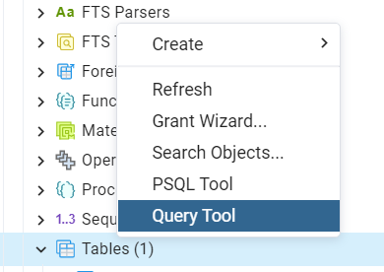
2. Using PostgreSQL in Windows (2b)
pgAdmin 4 (database admin tool for PostgreSQL)
Using the query tool

Slide 8
3. PostgreSQL – Data types
Numeric Types
Monetary Types
Character Types
Binary Data Types
Date/Time Types
Boolean Type
Enumerated Types
Network Address Types
Bit String Types
Geometric Types
Points
Line Segments,
Boxes, Paths
Polygons
Circles
Text Search Types
XML Type
Composite Types
Arrays
Object Identifier Types
Pseudo-Types

Slide 9
4. PostgreSQL – user defined types (1)
Enumerated types: data types that comprise of a static, ordered set of values.
Similar to HLL enum types e.g.:
CREATE TYPE mood AS ENUM ('sad', 'ok', 'happy');
e.g. of Enum Usage
CREATE TABLE person (
name text, current_mood mood );
INSERT INTO person
VALUES ('Cyril', 'happy');
SELECT * FROM person WHERE current_mood = 'happy';
Notes:
Enumerated (enum) types are data types that comprise a static, ordered set of values.

Slide 10
5. PostgreSQL – user defined types (2a)
Composite types similar to HLL record / struct types e.g.:
CREATE TYPE inventoryItem AS (
name text,
supplierID integer,
price numeric);
e.g. of usage of composite type
CREATE TABLE StockOnHand (
item inventoryItem, quantity integer);
INSERT INTO StockOnHand VALUES
( ROW ('gismo', 42, 1.99), 1000);

Slide 11
6. PostgreSQL – user defined types (2b)
Composite types contnd.
CREATE TYPE inventoryItem AS (
name text, supplierID integer, price numeric);
e.g. of usage of composite type
CREATE TABLE StockOnHand (
item inventoryItem, quantity integer);
SELECT (StockOnHand.item).name,
(StockOnHand.item).price,
StockOnHand.quantity
FROM StockOnHand
WHERE (StockOnHand.item).price > 0.99;

Slide 12
ODMG Object Model and Object Definition Language ODL
ODMG object model
ODMG- Object Data Management Group
Data model for object definition language (ODL) and object query language (OQL)
Objects and Literals
Basic building blocks of the object model
Object has five aspects:
Identifier, name, lifetime, structure, and creation
Literal
Value that does not have an object identifier
Notes:
The primary goal of the ODMG was to put forward a set of specifications that allowed a developer to write portable applications for object database and object-relational mapping products.

Slide 13
The ODMG Object Model and the ODL (cont’d.)
Behavior refers to operations
State refers to properties (attributes)
Interface
Specifies only behavior of an object type
Typically noninstantiable
Class
Specifies both state (attributes) and behavior (operations) of an object type
Instantiable

Slide 14
Inheritance in the Object Model of ODMG
Behavior inheritance
Also known as IS-A or interface inheritance
Specified by the colon (:) notation
EXTENDS inheritance
Specified by keyword extends
Inherit both state and behavior strictly among classes
Multiple inheritance via extends not permitted

Slide 15
Built-in Interfaces and Classes in the Object Model
Collection objects
Inherit the basic Collection interface
i = o.create_iterator()
Creates an iterator object for the collection
To loop over each object in a collection
Collection objects further specialized into:
set, list, bag, array, and dictionary

Slide 16
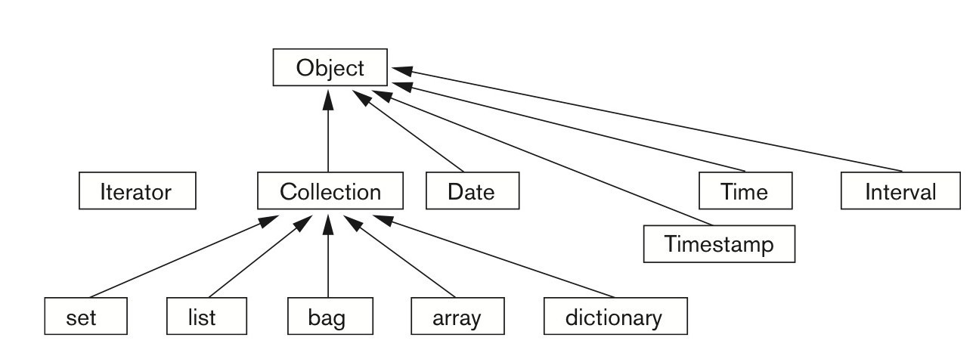
Figure 12.6 Inheritance hierarchy for the built-in interfaces of the object model

Slide 17
Extents, Keys, and Factory Objects
Extent
A persistent named collection object that contains all persistent objects of class
Key
One or more properties whose values are unique for each object in extent of a class
Factory object
Used to generate or create individual objects via its operations

Slide 18
Object Definition Language (ODL)
Support semantic constructs of ODMG object model
Independent of any particular programming language
Example on next slides of a UNIVERSITY database
Graphical diagrammatic notation is a variation of EER diagrams
Notes:
Object Definition Language (ODL) is the specification language defining the interface to object types confor.
Enhanced entity-relationship (EER) diagrams are basically a more expansive version of ER diagrams. EER models are helpful tools for designing databases with high-level models. ming to the ODMG Object MObject Definition Language ODL
odel. Often abbreviated by the acronym ODL

Slide 19
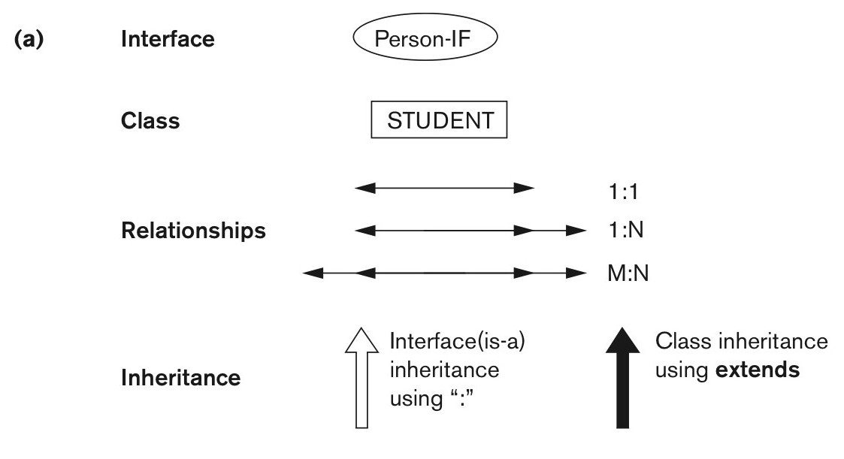
Figure 12.9a An example of a database schema. Graphical notation for representing ODL schemas.
continued on next slide

Slide 20
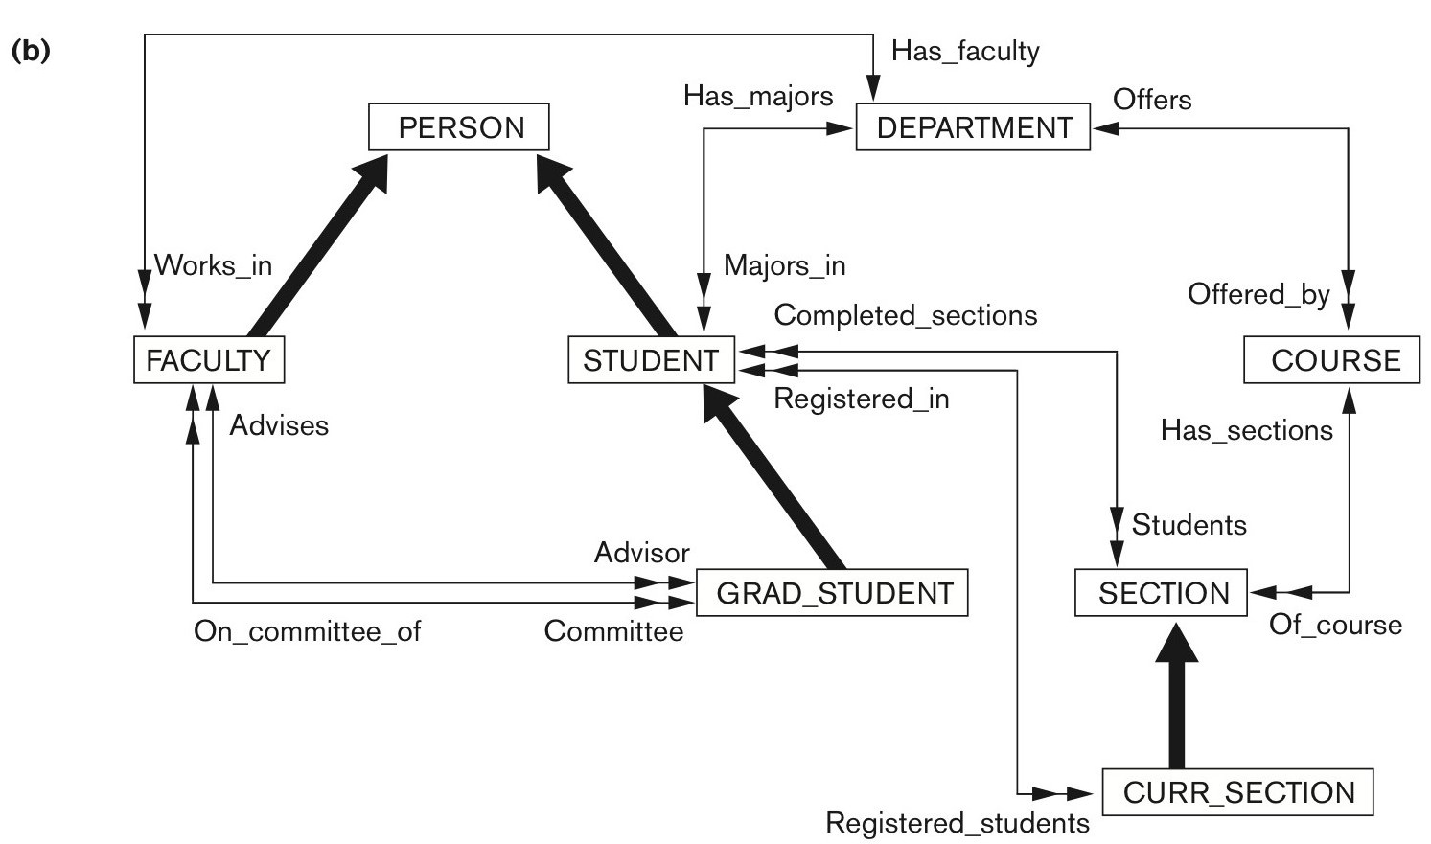
Figure 12.9b An example of a database schema. A graphical object database schema for part of the UNIVERSITY database (GRADE and DEGREE classes are not shown).

Slide 21
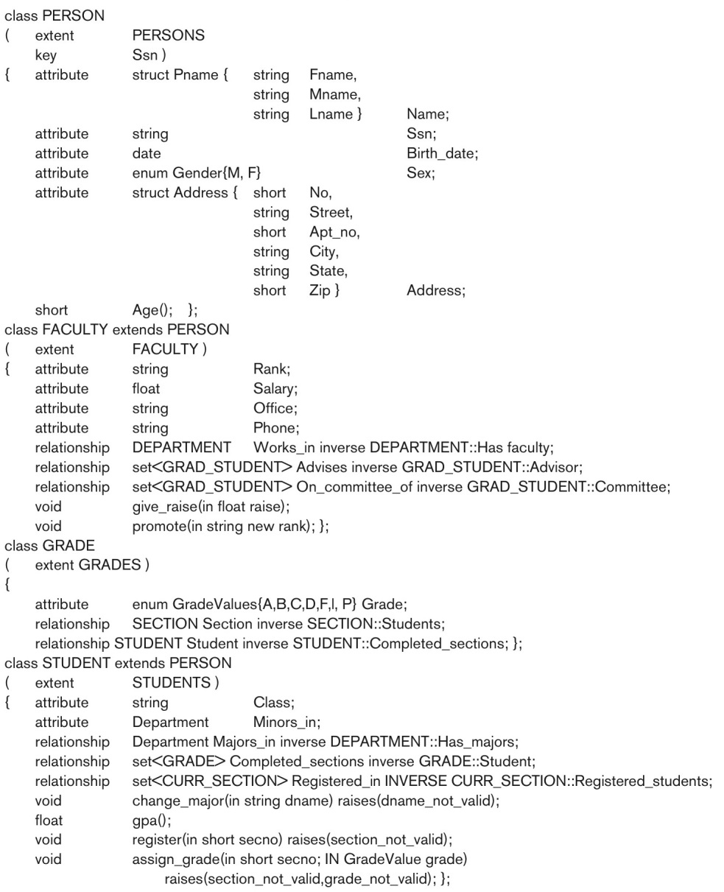
Figure 12.10 Possible ODL schema for the UNIVERSITY database in Figure 12.9(b).
continued on next slide

Slide 22
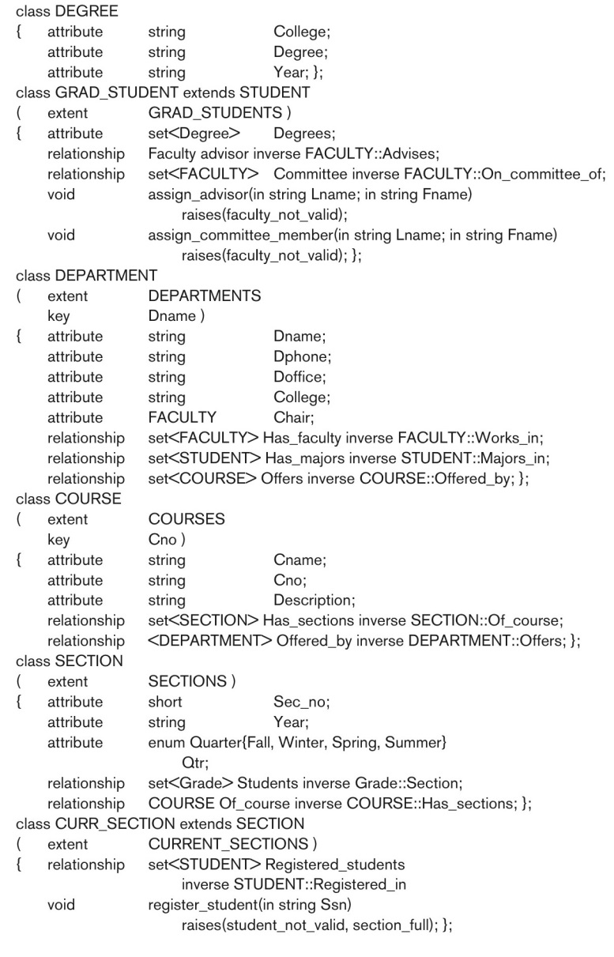
Figure 12.10 (continued) Possible ODL schema for the UNIVERSITY database in Figure 12.9(b).

Slide 23
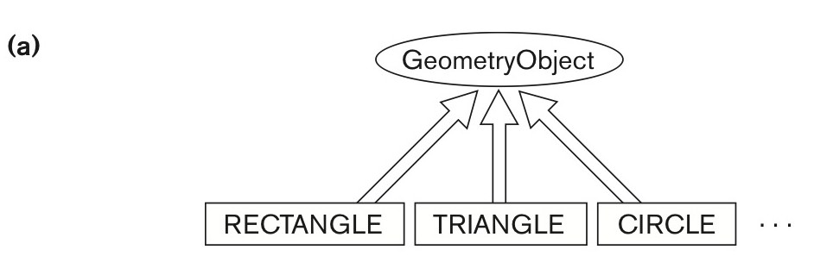
Figure 12.11a An illustration of interface inheritance via “:”. Graphical schema representation.
continued on next slide

Slide 24
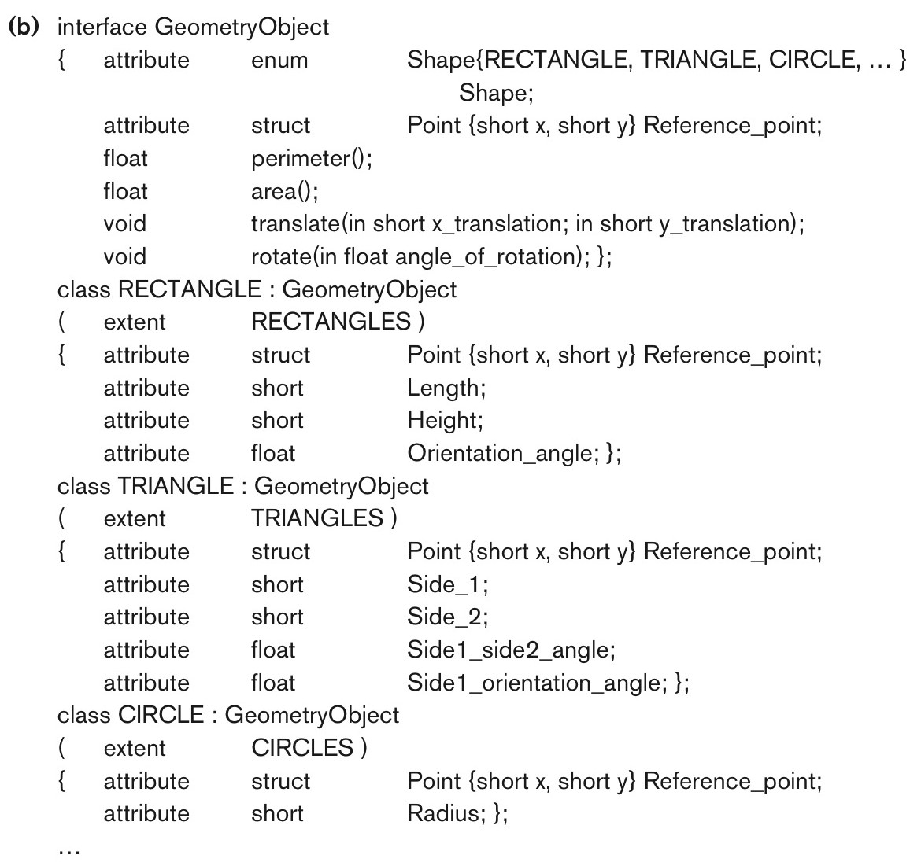
Figure 12.11b An illustration of interface inheritance via “:”. Corresponding interface and class definitions in ODL.

Slide 25
Object Database Conceptual Design
Differences between conceptual design of ODB and RDB, handling of:
Relationships
Inheritance
Philosophical difference between relational model and object model of data
In terms of behavioral specification

Slide 26
The Object Query Language OQL
Query language proposed for ODMG object model
Simple OQL queries, database entry points, and iterator variables
Syntax: select ... from ... where ... structure
Entry point: named persistent object
Iterator variable: define whenever a collection is referenced in an OQL query

Slide 27
Query Results and Path Expressions
Result of a query
Any type that can be expressed in ODMG object model
OQL orthogonal with respect to specifying path expressions
Attributes, relationships, and operation names (methods) can be used interchangeably within the path expressions

Slide 28
Other Features of OQL
Named query
Specify identifier of named query
OQL query will return collection as its result
If user requires that a query only return a single element use element operator
Aggregate operators
Membership and quantification over a collection

Slide 29
Other Features of OQL (cont’d.)
Special operations for ordered collections
Group by clause in OQL
Similar to the corresponding clause in SQL
Provides explicit reference to the collection of objects within each group or partition
Having clause
Used to filter partitioned sets

